Slide 1






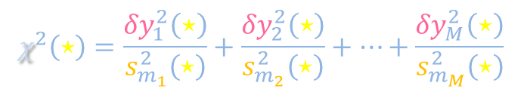


Sample variance fitting
$$y\left(x\right)$$
$$x_{1}$$
$$x_{2}$$
$$x_{3}$$
$$x_{4}$$
$$x_{5}$$
$$x$$
$$χ^{2}\left(⋆\right)=\frac{{δy}_{1}^{2}\left(⋆\right)}{s_{m_{1}}^{2}\left(⋆\right)}+\frac{{δy}_{2}^{2}\left(⋆\right)}{s_{m_{2}}^{2}\left(⋆\right)}+⋯+\frac{{δy}_{M}^{2}\left(⋆\right)}{s_{m_{M}}^{2}\left(⋆\right)}$$
$$\min_{PARAMS}{χ^{2}\left(⋆\right)}∼M−N_{PARAM}$$

Slide 2







Comparing data to a priori distributions
$$y\left(x\right)$$
$$x_{1}$$
$$x_{2}$$
$$x_{3}$$
$$x_{4}$$
$$x_{5}$$
$$x$$

Slide 3






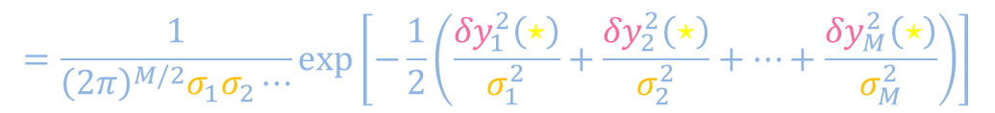





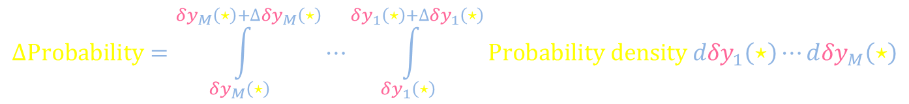


Comparing data to a priori distributions
$$\left|{δy}_{i}\left(⋆\right)\right|∼σ_{i}$$
$$y\left(x\right)$$
$$σ_{3}$$
$$σ_{4}$$
$$σ_{1}$$
$$δy_{2}\left(⋆\right)$$
$$δy_{3}\left(⋆\right)$$
$$σ_{5}$$
$$σ_{2}$$
$$δy_{5}\left(⋆\right)$$
$$δy_{4}\left(⋆\right)$$
$$\left\langle χ^{2}\right\rangle =M$$
$$δy_{1}\left(⋆\right)$$
$$x_{1}$$
$$x_{2}$$
$$χ^{2}\left(⋆\right)$$
$$x_{3}$$
Context implied throughout slide deck
$$x_{4}$$
$$x_{5}$$
$$x$$
$$P\left({δy}_{1}\left(⋆\right),{δy}_{2}\left(⋆\right),⋯\right)=P_{1}\left({δy}_{1}\left(⋆\right)\right)∙P_{2}\left({δy}_{2}\left(⋆\right)\right)⋯$$
$$=\frac{1}{{\left(2π\right)}^{M/2}σ_{1}σ_{2}⋯}\exp\left[−\frac{1}{2}\left(\frac{{δy}_{1}^{2}\left(⋆\right)}{σ_{1}^{2}}+\frac{{δy}_{2}^{2}\left(⋆\right)}{σ_{2}^{2}}+⋯+\frac{{δy}_{M}^{2}\left(⋆\right)}{σ_{M}^{2}}\right)\right]$$
$$∆Probability=\int_{{δy}_{M}\left(⋆\right)}^{{δy}_{M}\left(⋆\right)+∆{δy}_{M}\left(⋆\right)}{⋯\int_{{δy}_{1}\left(⋆\right)}^{{δy}_{1}\left(⋆\right)+∆{δy}_{1}\left(⋆\right)}{Probability density d{δy}_{1}\left(⋆\right)⋯d{δy}_{M}\left(⋆\right)}}$$

Slide 4









Sample variance fitting
$$y\left(x\right)$$
Example parameters
1) Horizontal stretch x_{1/2}
2) Vertical offset y₀
$$y\left(x\right)$$
$$x$$
$$x_{1}$$
$$x_{2}$$
$$x_{3}$$
$$x_{4}$$
$$x_{5}$$
$$x$$

Slide 5
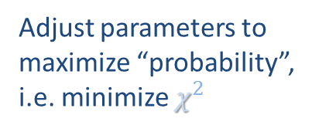
Sample variance fitting
$$y\left(x\right)$$
Example parameters
1) Horizontal stretch x_{1/2}
2) Vertical offset y₀
$$y\left(x\right)$$
$$x$$
$$x_{1}$$
Adjust parameters to maximize “probability”, i.e. minimize $χ^{2}$
$$x_{2}$$
$$x_{3}$$
$$x_{4}$$
$$x_{5}$$
$$x$$
$$P\left({δy}_{1}\left(⋆\right),{δy}_{2}\left(⋆\right),⋯\right)∼\frac{1}{{\left(2π\right)}^{M/2}s_{m_{1}}s_{m_{2}}⋯}\exp\left[−\frac{1}{2}\left(\frac{{δy}_{1}^{2}\left(⋆\right)}{s_{m_{1}}^{2}\left(⋆\right)}+\frac{{δy}_{2}^{2}\left(⋆\right)}{s_{m_{2}}^{2}\left(⋆\right)}+⋯+\frac{{δy}_{M}^{2}\left(⋆\right)}{s_{m_{M}}^{2}\left(⋆\right)}\right)\right]$$

Slide 6






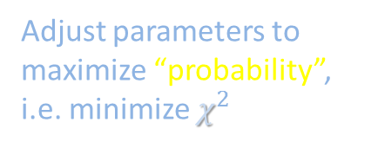
Sample variance fitting
Big δys
χ² big
$$y\left(x\right)$$
$$y\left(x\right)$$
Example parameters
1) Horizontal stretch x_{1/2}
2) Vertical offset y₀
$$y\left(x\right)$$
Big δys
χ² big
$$y\left(x\right)$$
$$x$$
Small δys
χ² small
$$y\left(x\right)$$
$$x$$
$$x_{1}$$
Adjust parameters to maximize “probability”, i.e. minimize $χ^{2}$
$$x$$
Adjust parameters to maximize “probability”, i.e. minimize $χ^{2}$
$$x_{2}$$
$$x_{3}$$
$$x$$
$$x_{4}$$
$$x_{5}$$
$$x$$
$$P\left({δy}_{1}\left(⋆\right),{δy}_{2}\left(⋆\right),⋯\right)∼\frac{1}{{\left(2π\right)}^{M/2}s_{m_{1}}s_{m_{2}}⋯}\exp\left[−\frac{1}{2}\left(\frac{{δy}_{1}^{2}\left(⋆\right)}{s_{m_{1}}^{2}\left(⋆\right)}+\frac{{δy}_{2}^{2}\left(⋆\right)}{s_{m_{2}}^{2}\left(⋆\right)}+⋯+\frac{{δy}_{M}^{2}\left(⋆\right)}{s_{m_{M}}^{2}\left(⋆\right)}\right)\right]$$

Slide 7

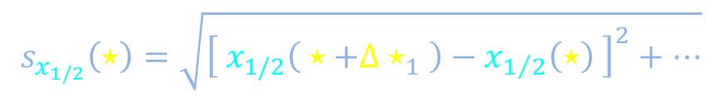


Sample variance fitting
$$y\left(x\right)$$
$$s_{x_{1/2}}\left(⋆\right)=\sqrt{{\left[ x_{1/2}\left( ⋆+{∆⋆}_{1} \right)−x_{1/2}\left(⋆\right) \right]}^{2}+⋯}$$
$$y\left(x\right)$$
$$x$$
$$\min_{PARAMS}{χ^{2}\left(⋆\right)}$$
$$x_{1/2}\left(⋆\right)±s_{x_{1/2}}\left(⋆\right)$$
$$y_{0}\left(⋆\right)±s_{y_{0}}\left(⋆\right)$$
$$x_{1}$$
Adjust parameters to maximize “probability”, i.e. minimize $χ^{2}$
$$x_{2}$$
$$x_{3}$$
$$x_{4}$$
$$x_{5}$$
$$x$$
$$P\left({δy}_{1}\left(⋆\right),{δy}_{2}\left(⋆\right),⋯\right)∼\frac{1}{{\left(2π\right)}^{M/2}s_{m_{1}}s_{m_{2}}⋯}\exp\left[−\frac{1}{2}\left(\frac{{δy}_{1}^{2}\left(⋆\right)}{s_{m_{1}}^{2}\left(⋆\right)}+\frac{{δy}_{2}^{2}\left(⋆\right)}{s_{m_{2}}^{2}\left(⋆\right)}+⋯+\frac{{δy}_{M}^{2}\left(⋆\right)}{s_{m_{M}}^{2}\left(⋆\right)}\right)\right]$$

Slide 8





Sample variance fitting
IF the fitting curve can be adjusted to be “correct,”
$$\min_{PARAMS}{χ^{2}\left(∎\right)}$$
$$\min_{PARAMS}{χ^{2}\left(Δ\right) }$$
$${\left\langle \min_{PARAMS}{χ^{2}\left(⋆\right)} \right\rangle }_{⋆}=M−N_{PARAM}$$
$$ν$$
$$y\left(x\right)$$
$$\frac{\min_{PARAMS}{χ^{2}\left(⋆\right)} }{ν }∼1$$
$$\min_{PARAMS}{χ^{2}\left(⋆\right)}$$
$$x_{1/2}\left(⋆\right)±s_{x_{1/2}}\left(⋆\right)$$
$$y_{0}\left(⋆\right)±s_{y_{0}}\left(⋆\right)$$
$$x_{1}$$
Adjust parameters to maximize “probability”, i.e. minimize $χ^{2}$
$$x_{2}$$
$$x_{3}$$
$$x_{4}$$
$$x_{5}$$
$$x$$
$$P\left({δy}_{1}\left(⋆\right),{δy}_{2}\left(⋆\right),⋯\right)∼\frac{1}{{\left(2π\right)}^{M/2}s_{m_{1}}s_{m_{2}}⋯}\exp\left[−\frac{1}{2}\left(\frac{{δy}_{1}^{2}\left(⋆\right)}{s_{m_{1}}^{2}\left(⋆\right)}+\frac{{δy}_{2}^{2}\left(⋆\right)}{s_{m_{2}}^{2}\left(⋆\right)}+⋯+\frac{{δy}_{M}^{2}\left(⋆\right)}{s_{m_{M}}^{2}\left(⋆\right)}\right)\right]$$

Slide 9
















Sample variance curve fitting algorithm
Big δys
χ² big
$$y\left(x\right)$$
Measure individual samples to construct sample means and standard errors at various x
$$\frac{\min_{PARAMS}{χ^{2}\left(⋆\right)} }{ν}∼1$$
3) Is
?
( $ν≔M−N_{PARAM}$ )
Justify fitting function and parameters.
$$y\left(x\right)$$
Do normalized residuals look plausibly like random noise?
$$\min_{PARAMS}{χ^{2}\left(⋆\right)}$$
Big δys
χ² big
$$y\left(x\right)$$
$$x$$
Small δys
χ² small
$$y\left(x\right)$$
$$\frac{{δy}_{i}\left(⋆\right)}{s_{m_{i}}}$$
5) IF pass QC, report
$$x_{1}$$
$$\min_{PARAMS}{χ^{2}\left(⋆\right)}$$
$$x_{2}$$
1
$$x_{3}$$
$$x$$
$$x_{1/2}\left(⋆\right)±s_{x_{1/2}}\left(⋆\right)$$
$$x_{4}$$
0
$$x$$
$$x$$
$$x_{5}$$
$$x$$
$$y_{0}\left(⋆\right)±s_{y_{0}}\left(⋆\right)$$
$$χ^{2}\left(⋆\right)$$
-1
$$P\left({δy}_{1}\left(⋆\right),{δy}_{2}\left(⋆\right),⋯\right)∼\frac{1}{{\left(2π\right)}^{M/2}s_{m_{1}}s_{m_{2}}⋯}\exp\left[−\frac{1}{2}\left(\frac{{δy}_{1}^{2}\left(⋆\right)}{s_{m_{1}}^{2}\left(⋆\right)}+\frac{{δy}_{2}^{2}\left(⋆\right)}{s_{m_{2}}^{2}\left(⋆\right)}+⋯+\frac{{δy}_{M}^{2}\left(⋆\right)}{s_{m_{M}}^{2}\left(⋆\right)}\right)\right]$$

